Slide 1
Engineering design 2026
Lecture Week 2
Deck 2
Risk and Management
Never assume!
It makes your life unpredictable but interesting
Prof Henri Marais
30 Jul 2025

Slide 2
Risk management process
Initial
Risk
Open
Unknown
Identify risk
Likelihood Impact
Categorize risk
Determine impact
Initial risk acceptance
Notes:
Initially all risks start out as unknown (ergo it being a risk…) essentially if you were to do nothing at this point you accept this risk and continue. This is dangerous (obviously) since you literally don’t know what you’ve agreed to accept…
So the first step is to identify that there is risk, then to identify risks and categorise these risks. Thereafter, you determine the likelihood of the identified risk occurring (this is a bit of a guessing game – informed by experience) and also the impact that it would have should it occur.
As an example, let’s take the writing of an exam in a module. Obviously, there is a lot of risks but let’s assume you’re seated and ready to go.
Identified risk : Pen is not working
Categorise: Technical risk (something is malfunctioning / not working as it should)
Likelihood: I have cheap pens so 50%
Impact: Severe. Can’t write down any answers.
Ok so now what?

Slide 3
Risk management process
Initial
Risk
Open
Consequences
Unknown
Identify risk
Likelihood Impact
Categorize risk
Determine impact
Initial risk acceptance
Mitigation Cost
Mitigation(s)
Identify alternatives
Trade-off between
cost and residual risk
Notes:
Ok the next step is to identify the consequences. In this example that is pretty clear. We then make a list of possible ways in which we can reduce the risk of this event happening (mitigations). This requires some experience / homework / guidance. Thereafter, you determine the cost of the mitigations against the cost of the consequence(s). Aiming for the highest reduction for the least cost. You might also need to implement multiple mitigations for a single risk (depending on the severity of course).
Ok so for our example…
Consequence(s): Fail exam (possibly module), might lead to failing the year, etc.
Mitigations:
- Write exam in close proximity to stationary store
- Make loads of friends so that I can borrow a pen
- Get more than 1 pen
Mitigation costs:
- Write in close proximity (not within your control) – ignored
- Make loads of friends (ok, but this only works if I forgot my pen at home, not during the exam) – ignored
- Get more pens (R10/pen, failed module R5000) – this looks like a good option

Slide 4
Risk management process
Initial
Risk
Open
Consequences
Unknown
Identify risk
Likelihood Impact
Categorize risk
Determine impact
Initial risk acceptance
Known
Residual
Risk
Mitigation Cost
Mitigation(s)
Monitor Control
Measure, control and adjust
Identify alternatives
Residual risk acceptance
Trade-off between
cost and residual risk
Notes:
So, at this point the risk is known, and the residual risk is also known (and quantifiable). In this example your backup pen might also fail… There is residual risk (but much less than having only a single pen) and this risk can be accepted (you know what you are dealing with). The likelihood of both pens failing is much less than if you just had one pen.
Finally, you monitor the risk, its associated mitigation, and control accordingly. If things change revise as required.
In our example, monitoring might be that you check the remaining ink level in both your usual pen and the backup one, and that you test each pen the day before. Control would be replacing the pen when the ink reaches a certain level, or if either of the pens don’t function as expected during the testing beforehand.

Slide 5
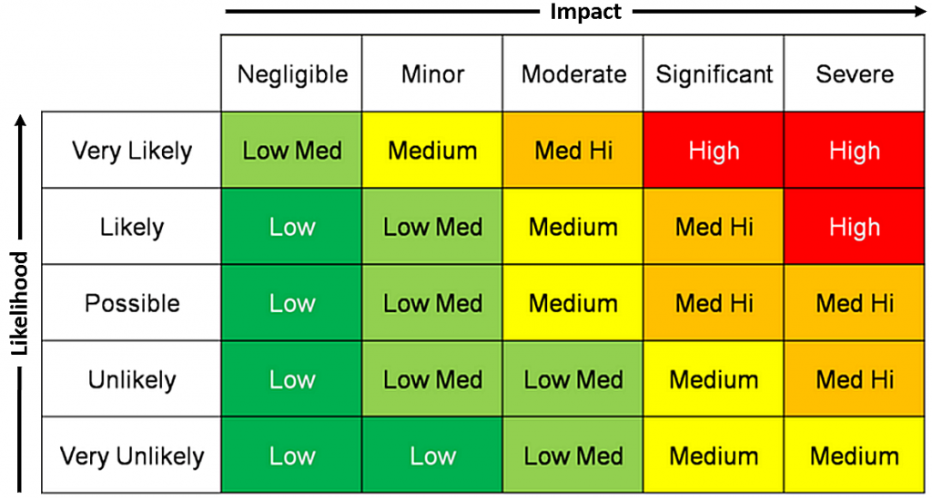
Risk Evaluation Matrix
5
4
3
2
1
1
2
3
4
5
Notes:
Based on the information on the previous slides’ information this table can be used to determine a score for an identified risk.
For the pen example (prior to mitigation) the impact would be severe, and the likelihood of occurrence likely. So that puts you at a high risk level (meaning that it needs significant attention).
After mitigation, the impact of your pen not working is still severe BUT since you have 2 pens now the likelihood has reduced to very unlikely. So the risk has fallen from 25, to 5 which is quite a reduction.

Slide 6
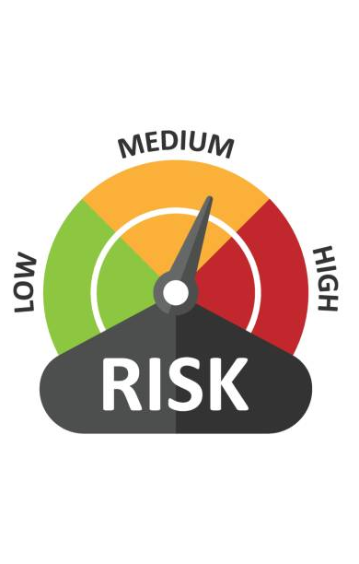
Risk management (overall)
A tool used in planning work (primarily)
Can be a specialist skill (only introductory for now)
True risk is never completely absolved

Slide 7
Risk categories (MUST USE)
S – Schedule Risk (all events that may result in a time delay)
Risk: Access to data (for example) may delay communication, or similar
Impact: Medium
Likelihood: High (load shedding, data costs, remote areas of work)
Mitigation: Ensure members stay in contact / inform lecturer
G – Group Risk (events that may result in the group failing to work together)
Risk: Team member not performing duties, leading to lack of deliverables
Impact: High
Likelihood: High (why – because this always happens in group work)
Mitigation: Perform work management, measure performance
K – Knowledge Risk (events relating to my own knowledge)
Risk: Not knowing how KiCAD works leads to unmanufacturable boards being produced
Impact: High (obviously depending on what your SoW is)
Likelihood: High (You’ve never used this tool)
Mitigation: Identify and complete a suitable tutorial on KiCAD usage.

Slide 8
Risk categories (MUST USE)
P – Project Risk (all events that may result in the project failing)
Risk: Counterfeit components that do not function as expected
Impact: Severe
Likelihood: High (I used cheap AliExpress suppliers)
Mitigation: Only use known-good suppliers with supply chain integrity
L – Logistics Risk (events that affect technical execution)
Risk: Components ordered are stuck at customs
Impact: Severe (cannot execute without components)
Likelihood: Possible (process outside of your control)
Mitigation: Place component orders early to mitigate impact

Slide 9
Risk numbers (traceability)
Risks are numbered for ease of traceability
For example:
Group risks
1 – Risk event A, leading to Risk G1
2 – Risk event B, leading to Risk G2
3 – Risk event C, leading to Risk G3
Etc.

Slide 10
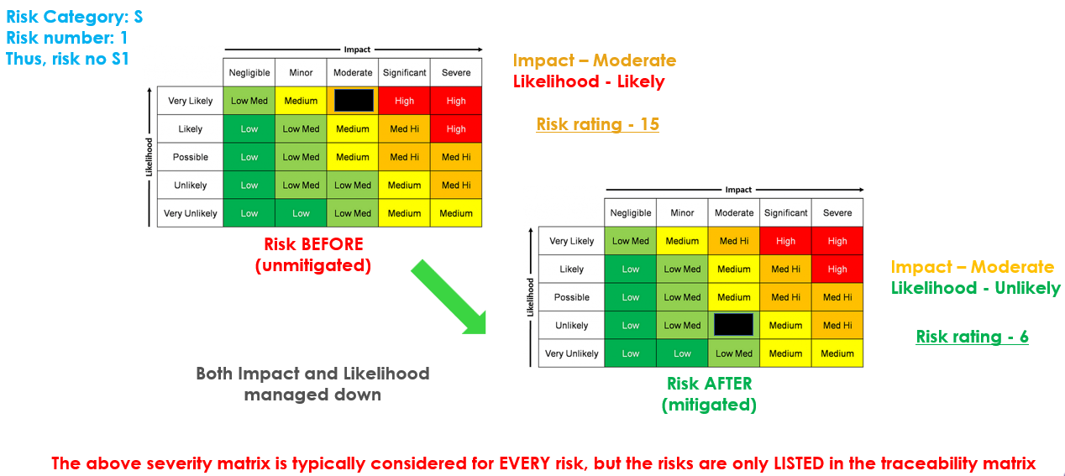
EXAMPLE APPLICATION

Slide 11
Usage
PUTTING THIS TO WORK

Slide 12
Risk as a management tool
Monitor open risks
Adjust risk likelihood and severity over time
(as work is completed)
Add risks that are identified as project progresses (as needed)

Slide 13
Commonly occurring events in engineering design
Procurement & Supply Chain Delays (L) | Long lead times for components, suppliers out of stock, import/customs issues (common in SA), or minimum order quantities. | High (delays entire build) | Early supplier research + multiple quotes; order critical/long-lead items in Week 1–2; maintain buffer stock or alternatives.
Integration Failures (P) | Subsystems (mechanical, electrical, software, control) don't work together; interface mismatches. | High (late-stage rework) | Early interface definitions & modular design; frequent subsystem integration tests (not just at the end); use mock-ups or simulations.
Material / Component Availability & Quality (L) | Wrong specs delivered, counterfeit/low-quality parts, or sudden unavailability. | Medium-High (cost + rework) | Specify exact standards; source from reputable local suppliers where possible; include quality inspection step on receipt.

Slide 14
Commonly occurring events in engineering design
Testing & Validation Issues (P / K) | Inadequate test equipment/facilities, safety risks during testing, or results not meeting requirements. | High (cannot prove design works) | Plan test protocols early; book lab time/slots in advance; include safety risk assessment + contingency for re-testing.
Budget Overruns (P) | Unexpected costs for materials, machining, shipping, or iterations. | Medium-High | Detailed BOM (Bill of Materials) with cost estimates + 20–30% contingency; track spending weekly.
Design Iteration Loops / Scope Creep (K) | Late changes due to testing failures or evolving requirements. | Medium-High (time sink) | Freeze design at key milestones; use change control process; rapid prototyping (3D printing, etc.) for early validation.

Slide 15
Some additional considerations
Logistical & Operational Risks
These arise from the physical, hands-on nature of design projects.
Workshop / Lab Access & Equipment Conflicts (L-1): Shared facilities booked by other groups, machine downtime, or limited hours. Mitigation: Book slots early; have backup locations or manual methods.
Transportation & Handling (L-2): Moving heavy/bulky prototypes, fragile components, or site-specific logistics (e.g., rural/farm testing). Mitigation: Plan transport early; use proper packaging/protection.
Manufacturing / Fabrication Risks (L-3): CNC/laser cutting delays, welding issues, tolerances not met by external fabricators. Mitigation: In-house capability checks; provide detailed drawings with tolerances.
Power / Infrastructure Dependencies (L-4): Load shedding, unstable power for testing, or site-specific issues. Mitigation: Solar/battery backups; schedule around known disruptions.
Documentation & Traceability (L-5): Poor version control of drawings, BOMs, or test data leading to integration errors. Mitigation: Use shared cloud drives with naming conventions + version history.

Slide 16
Some additional considerations
Team & Work Management Risks
Knowledge/Skill Gaps Across Disciplines (K-1): Mechanical vs. electrical vs. software team members misunderstanding each other’s constraints. Mitigation: Cross-training sessions + joint design reviews.
Unequal Hands-On Contribution (G-3): Some members dominate CAD/fabrication while others lag on testing/integration. Mitigation: Structured work management including detailed work planning, clear task allocation, formal acceptance of deliverables, and ongoing tracking (e.g., weekly progress updates against assigned tasks).
Personal/Logistical Constraints Impacting Practical Work (S | G | P): Commuting to workshops, residence commitments, or health issues affecting lab time. Mitigation: Proactive availability sharing + flexible sub-tasking.

Slide 17
Summary
Risk is ever present and takes several forms
Mitigation reduces the likelihood, severity, or both
Successful management reduces residual risk over time

